Slide 1
Topic: Coefficient of Determination
EQ: How does the coefficient of determination differ from the correlation coefficient?

Slide 2
To review
Pearson’s Correlation Coefficient, r
R is a measure of strength of the linear association between two variables, x and y.
It measures the direction and the strength of the linear association between two numerical paired variables.
Difference between Correlation and Regression
Correlation Coefficient, R, measures the strength of bivariate association
The regression line is a prediction equation that estimates the values of y for any given x

Slide 3
Limitations of the correlation coefficient
Though R measures how closely the two variables approximate a straight line, it does not validly measure the strength of nonlinear relationship
When the sample size, n, is small we also have to be careful with the reliability of the correlation
Outliers could have a marked effect on R
Remember: Correlation does not imply causality!

Slide 4
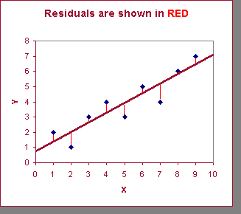
Least Squares Regression
Calculates the “best-fit” line for a certain set of data
The regression line makes the sum of the squares of the residuals smaller than for any other line
Regression minimizes residuals
GOAL - minimize the sum of the squared differences between the points (observed values) and the line (predicted values).

Slide 5
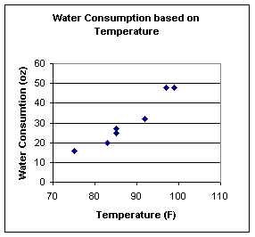
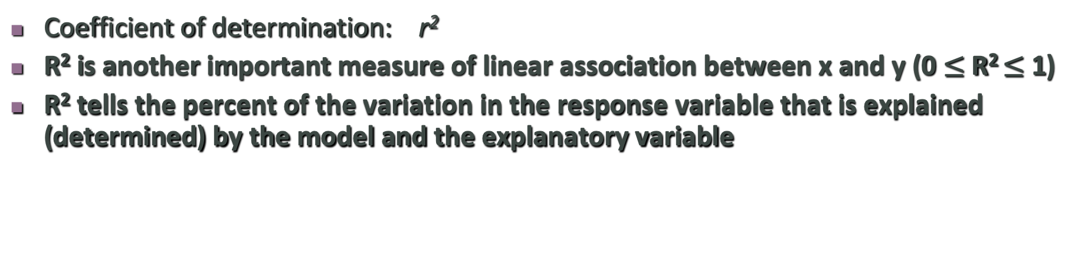
Strength of the Association: r²
Coefficient of determination: r²
R² is another important measure of linear association between x and y (0 $≤$ R² $≤$ 1)
R² tells the percent of the variation in the response variable that is explained (determined) by the model and the explanatory variable
Example: r² =92.7%.
Interpretation:
Almost 93% of the variability in the amount of water consumed is explained by outside temperature using this model.
Note: Therefore 7% of the variation in the amount of water consumed is not explained by this model using temperature.

Slide 6
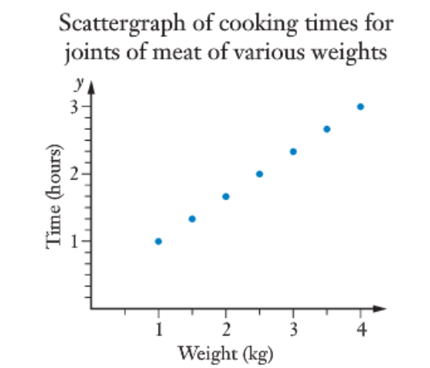
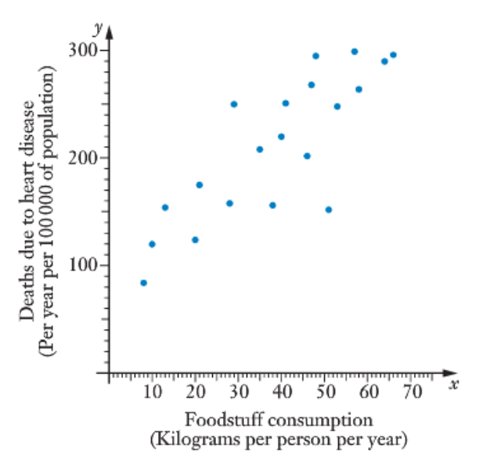
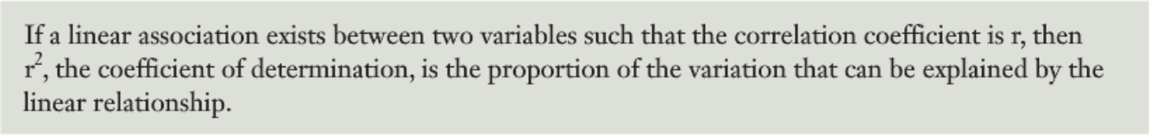
Here we have a perfect correlation, or r =1
R² is also 1
This means that 100% of the variation in the cooking time is explained, or accounted for, by the relationship between the two variables (cooking time and weight)
Here we have a correlation coefficient, of r = 0.823
R² = 0.677
This means that approx. 68% of the variation in death rates due to heart disease can be explained by the variation in foodstuff consumption

Slide 7
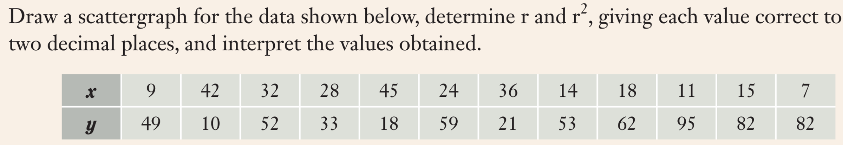
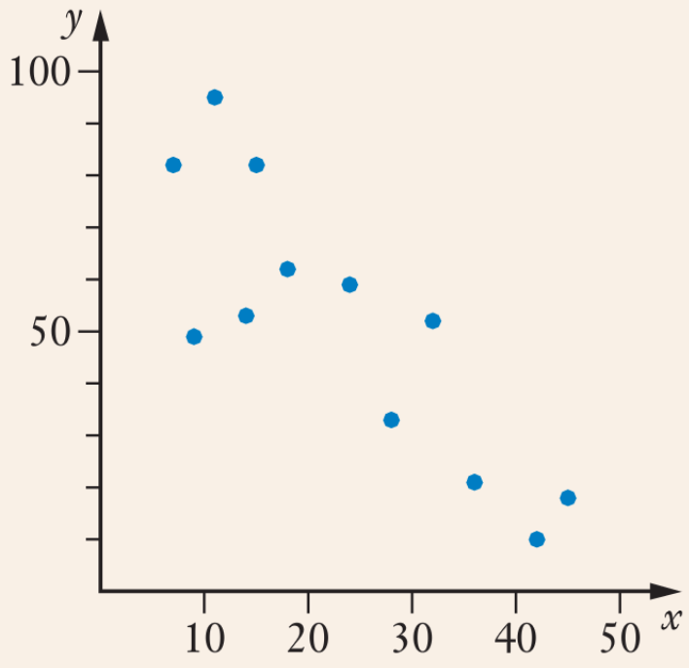
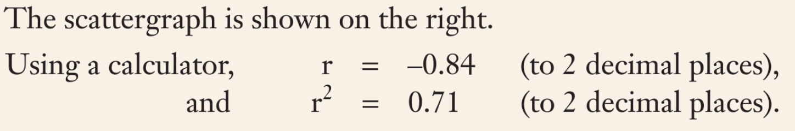
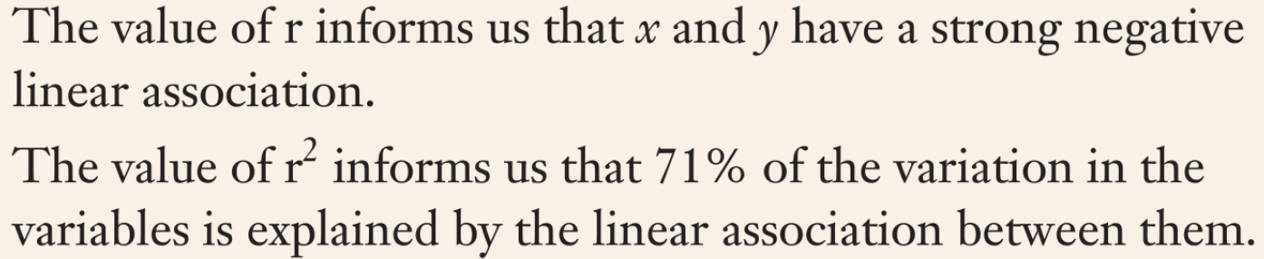

Slide 8

Practice
Sadler 2C
Notes:
Independent practice

